Slide 1

Handwritten Digit and Signal Recognition for Children
EIE4512 2023-24 Summer
2024/7
Group 1
Boshi Xu Yuhang Huang Yiwei Huang

Slide 2
01
Part1
Motivation
PART 01

Slide 3

“
In today's digital era, labor costs are increasingly expensive, and the digitalization of early childhood education has become an inevitable trend. To save parents and teachers from spending time on simple homework correction, we aim to design a program that can check children's answers of simple handwritten calculation.
Motivation
”
Notes:
运用到智能系统的子系统
有如下优点：
1、对生命体具有更好的识别能力
因为红外利用热辐射成像，任何高于绝对零度（-273℃）的生命体都会散发热量，所以能够呈现更清晰的图像。它弥补了“雷达+摄像头”依赖形状识别的不足，更好地保护行人。
2、夜间成像能力强
上文提到，因为红外技术是通过物体发出的热辐射来成像，并不依赖光成像，所以不管白天黑夜，它都能工作，可以弥补可见光成像夜间探测能力差的弊端。
3、雨雾等恶劣天气下，抗干扰能力强
因为红外辐射波的波长较长，所以其穿透力更好，因此即便是在沙尘、雾霾等恶劣的天气条件下，红外图像的成像效果依旧比较好，即红外图像的抗干扰能力较强。
4、无惧眩光
红外只接收中长波信息，不接收可见光波段信息，夜晚会车等强弱光交替场景仍能清晰成像，感知功能不会受到影响。这也是夜间使用比较常见的一个场景。
总结一下

Slide 4
02
Part2
Goal
PART 02

Slide 5
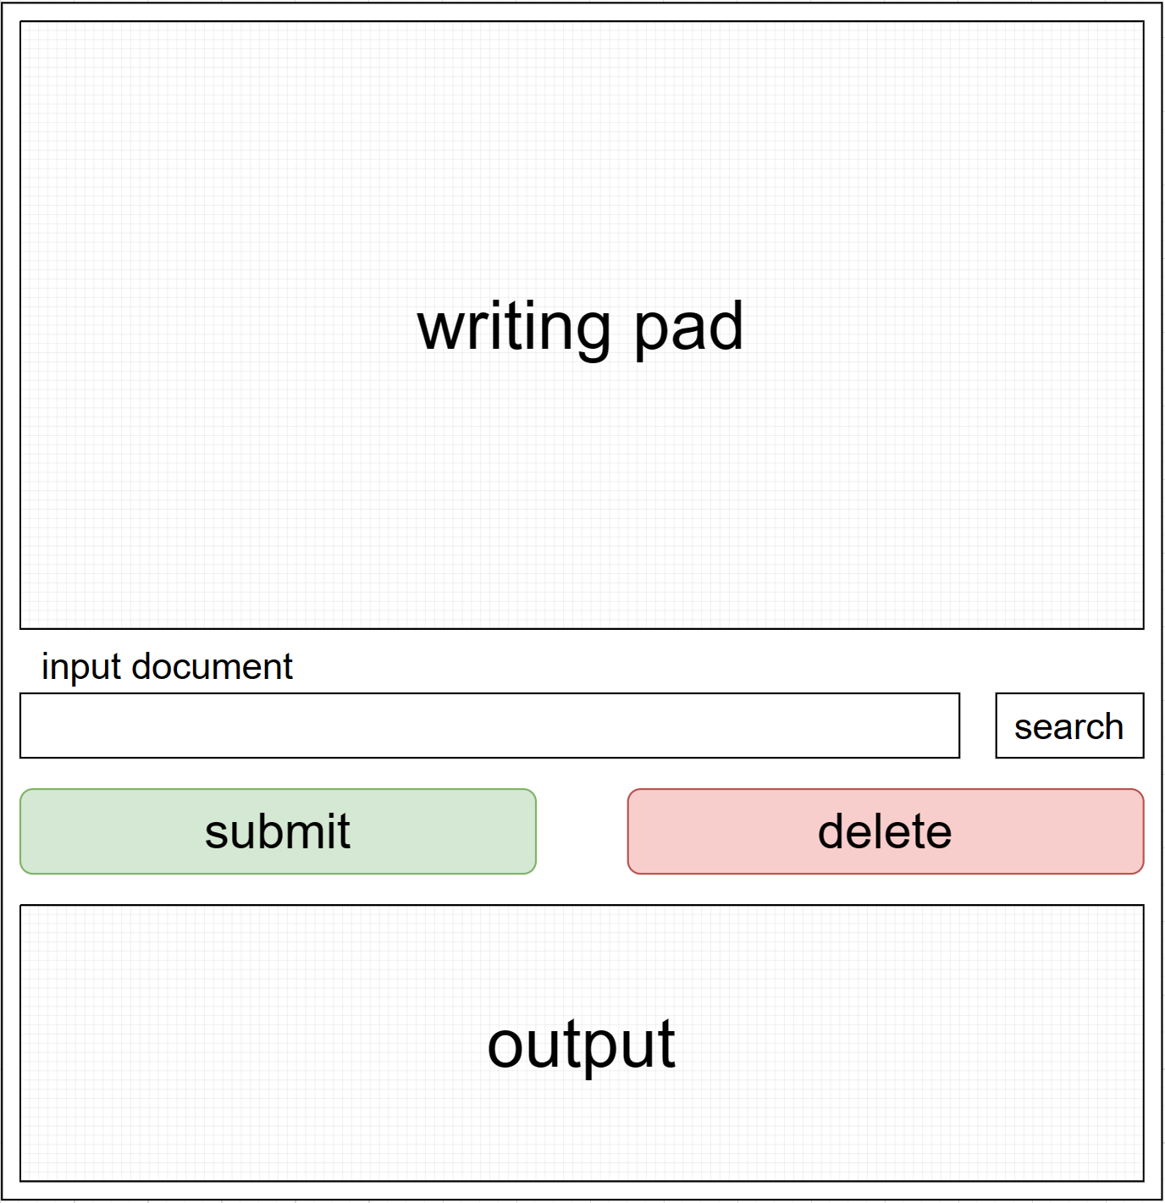
02 Goal
The goal of our project is to create a simple and easy-to-use handwritten recognition and calculation product.
The front-end part includes:
1. Handwriting board
2. Optional file input
3. Text result output

Slide 6
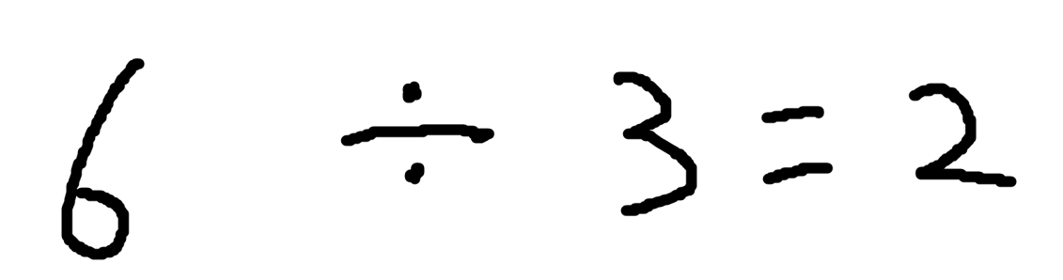
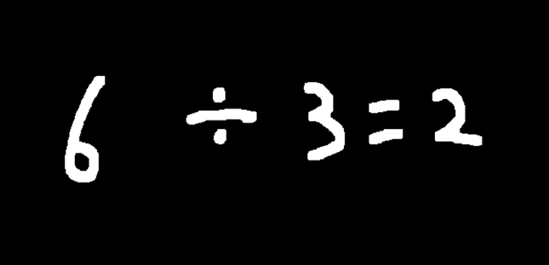
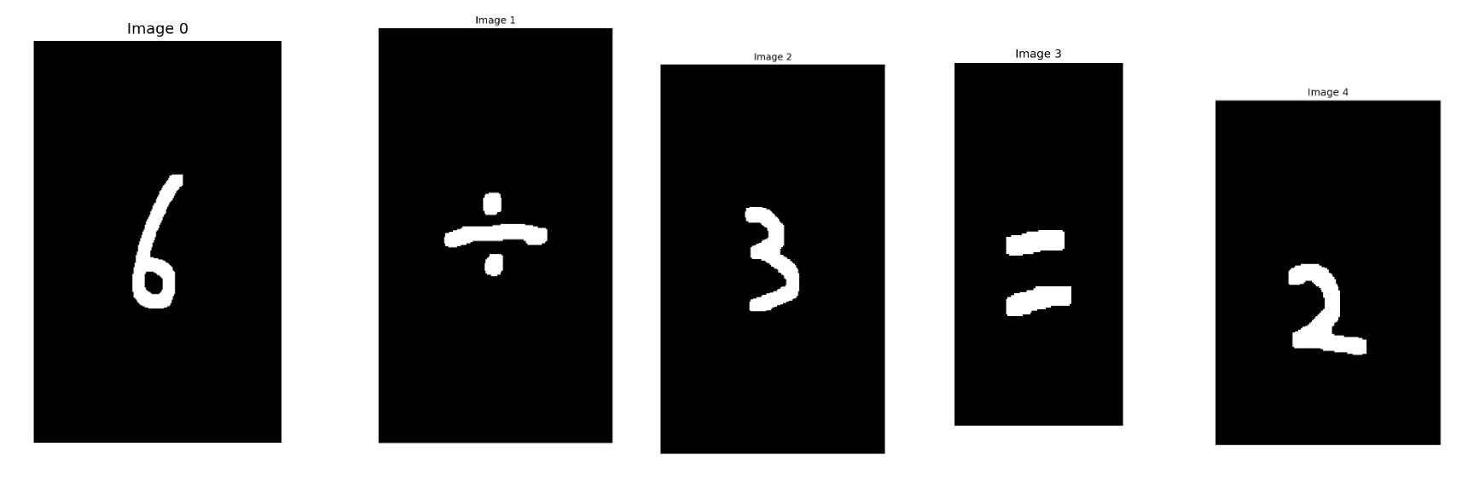
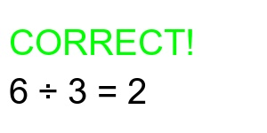
02 Goal
Pipline
Input from Handwritten Board or document
Read the input image
Image after processing
Output to the expected part of the frontend page
CNN proceed result
Separated Images

Slide 7
03
Part3
Datasets
PART 03

Slide 8
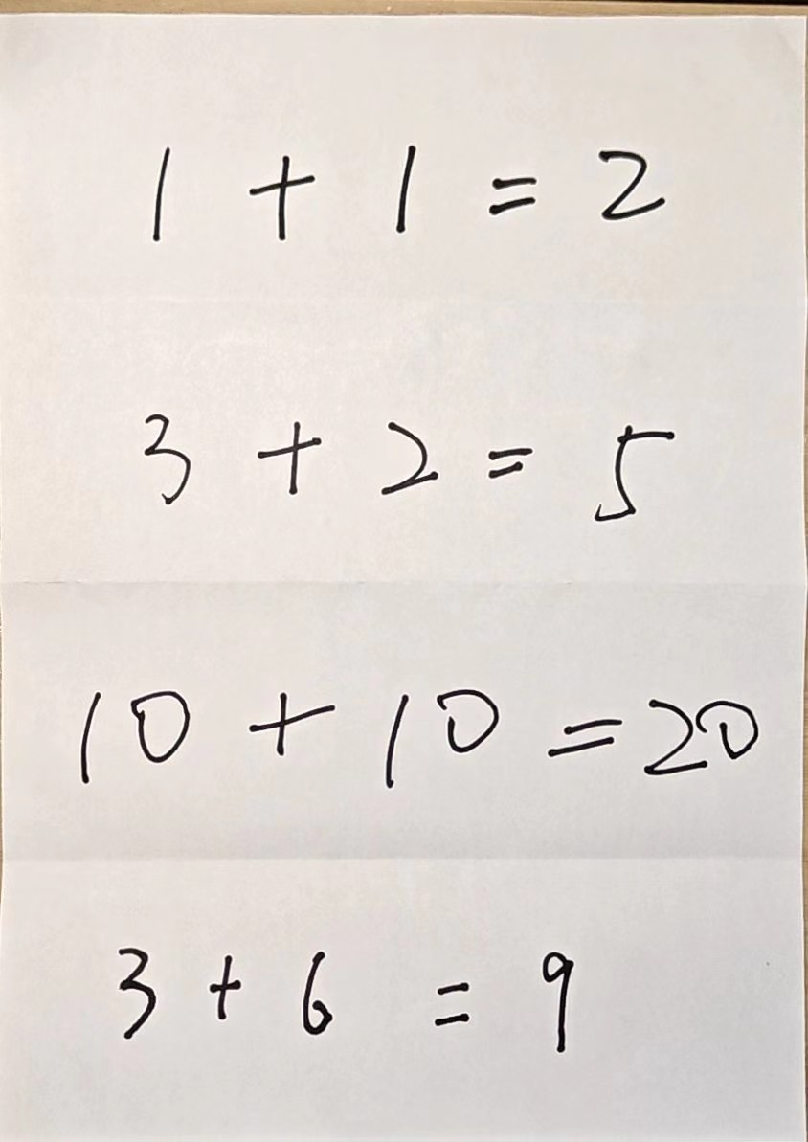
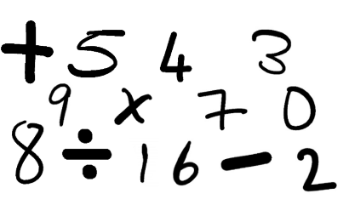
03 Datasets
The dataset combine with two parts:
1. Mathematics Symbols Data collected from the Internet
2. Numbers of children's handwriting pictures collected by ourselves.
Mathematics Symbols Data
Children’s handwriting

Slide 9
04
Part4
Methodology
PART 04

Slide 10

04 Methodology
1. OpenCV
Preprocessing
1. Preprocessing of Input Image
The input image is subjected to a series of operations including Gaussian blurring, edge detection, and dilation and erosion to facilitate subsequent processing.
Mathematics Symbols Data

Slide 11
04 Methodology
1. OpenCV
Splitting
Separated
Images
2. Using contour recognition to split equations into individual numbers and symbols.
Contour recognition is used to obtain correctly sized bounding boxes, which are then used to crop the image to obtain individual images. However, traditional contour recognition treats division signs and equal signs as multiple objects, resulting in multiple bounding boxes. Therefore, we identify division signs and equal signs by detecting the distance between each contour and considering two contours that are too close to each other as one.

Slide 12
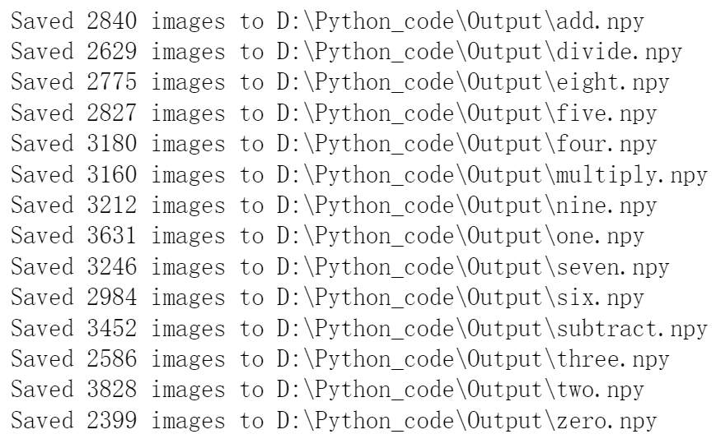
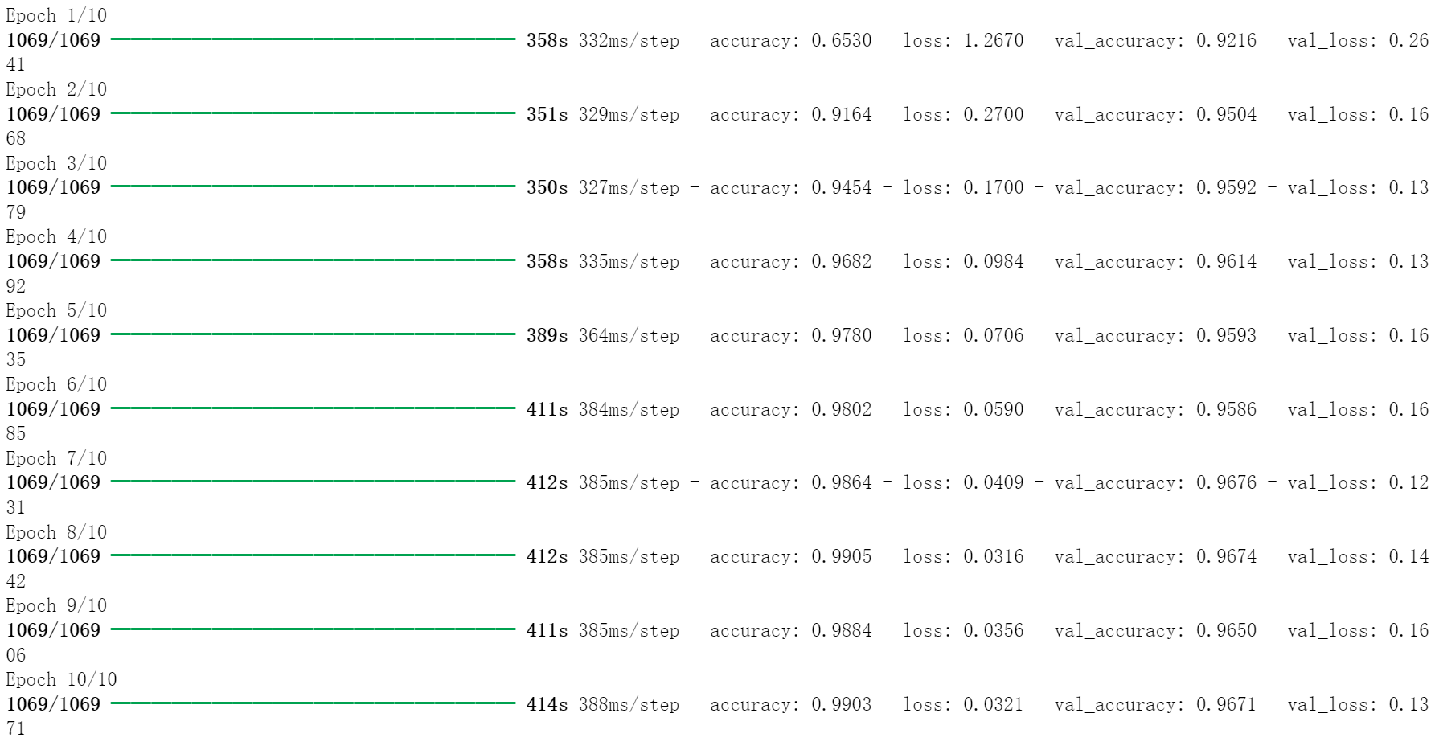
04 Methodology
2. CNN
Trainning
1. Process the data by collecting them to npy files of NumPy array.
2. Build and train a convolutional neural network (CNN) model named CNN_result.h5 to classify the images.

Slide 13
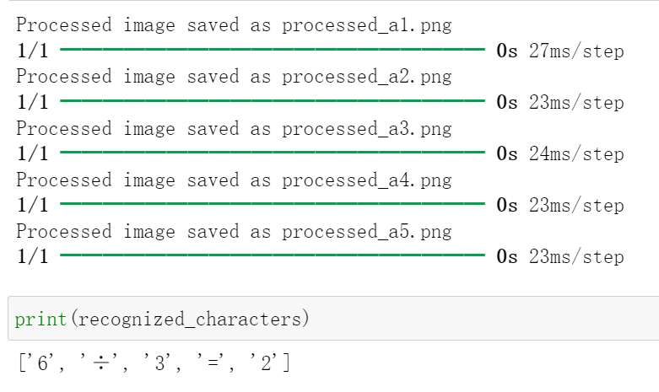
04 Methodology
2. CNN
Recognition
1. Read and preprocess the input images to fit the size of model.
2. Use trainned CNN model to recognize the characters in the image.
3. Check the calculations and output the result to the front dne.

Slide 14
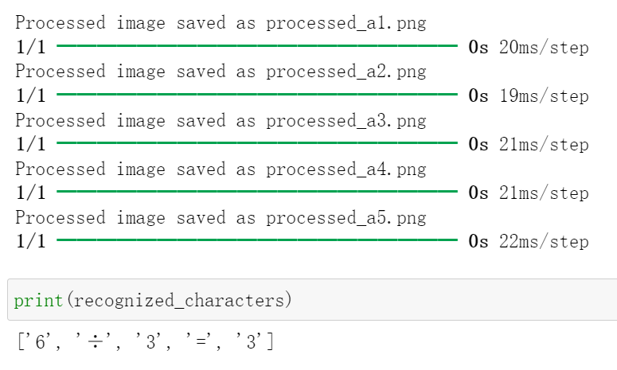
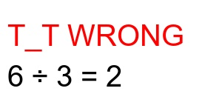
04 Methodology
2. CNN
Recognition
1. Read and preprocess the input images to fit the size of model.
2. Use trainned CNN model to recognize the characters in the image.
3. Check the calculations and output the result to the front dne.

Slide 15
04 Methodology
3. Front End
Complete the HTTP front-end code using the React framework.
Use the canvas context to track mouse movement and complete image drawing.
Implement image uploading using an input dom element with type=file.
Use a simple Python server and HTTP API to obtain the uploaded image from the front-end, call the algorithm, and return the resulting image.

Slide 16
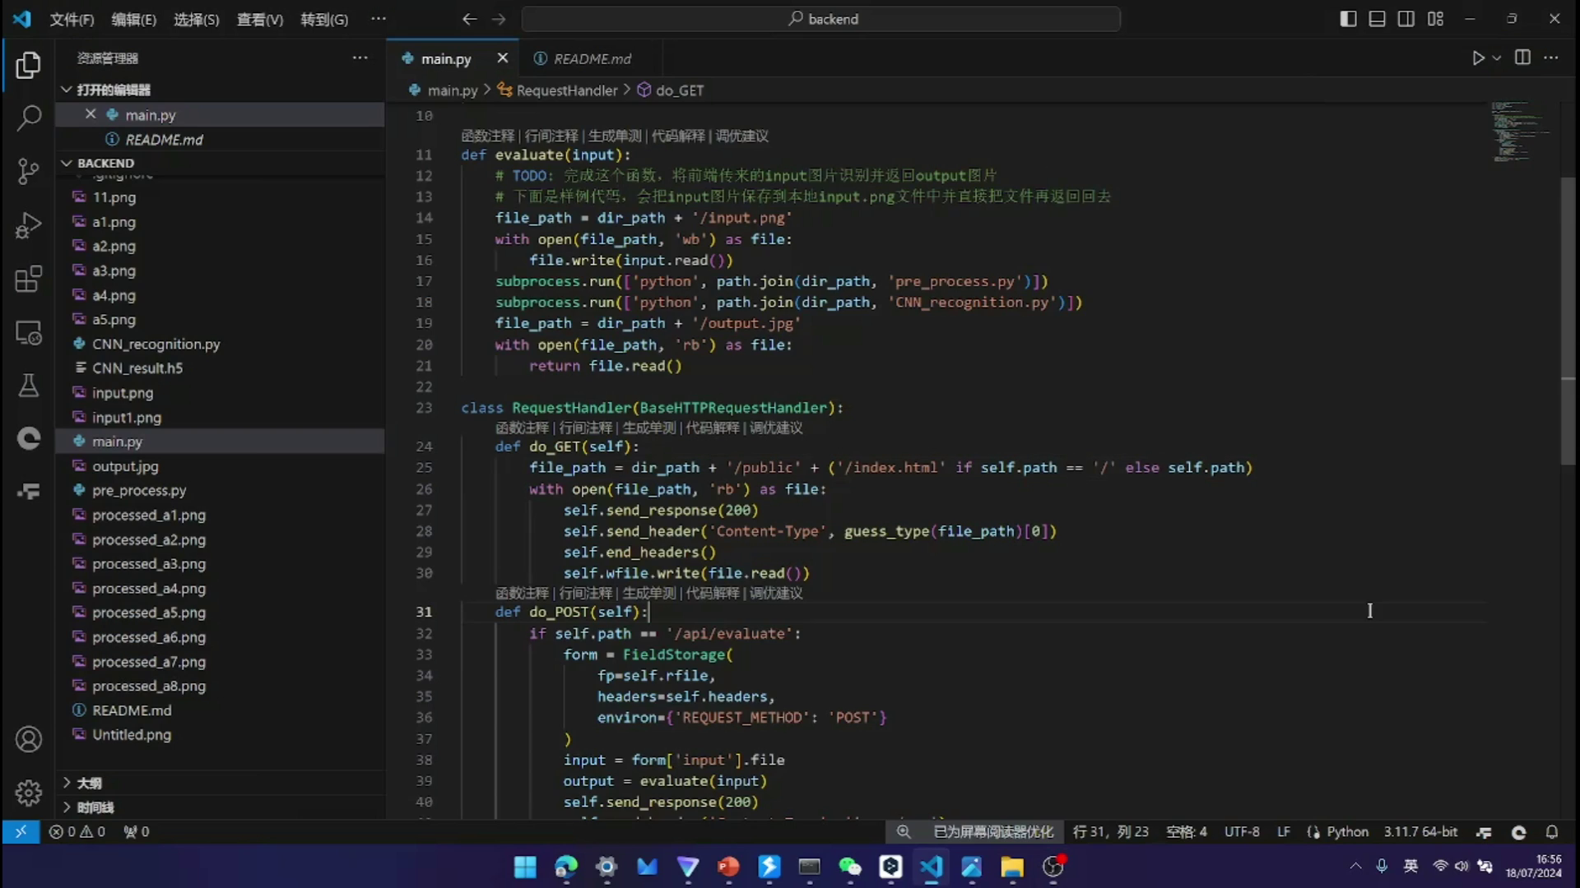
Video Presentation

Slide 17
Thank you for Watching

Slide 18
Appendix: Reference
CNN reference:
https://cloud.tencent.com/developer/article/2398369
Dataset 1 of images of numbers & operators to train for maths expression solver:
https://www.kaggle.com/datasets/amitamola/mathematics-symbols-data/data
Dataset 2 of images of numbers & operators to train:
Collected by Teammates

